Slide 1
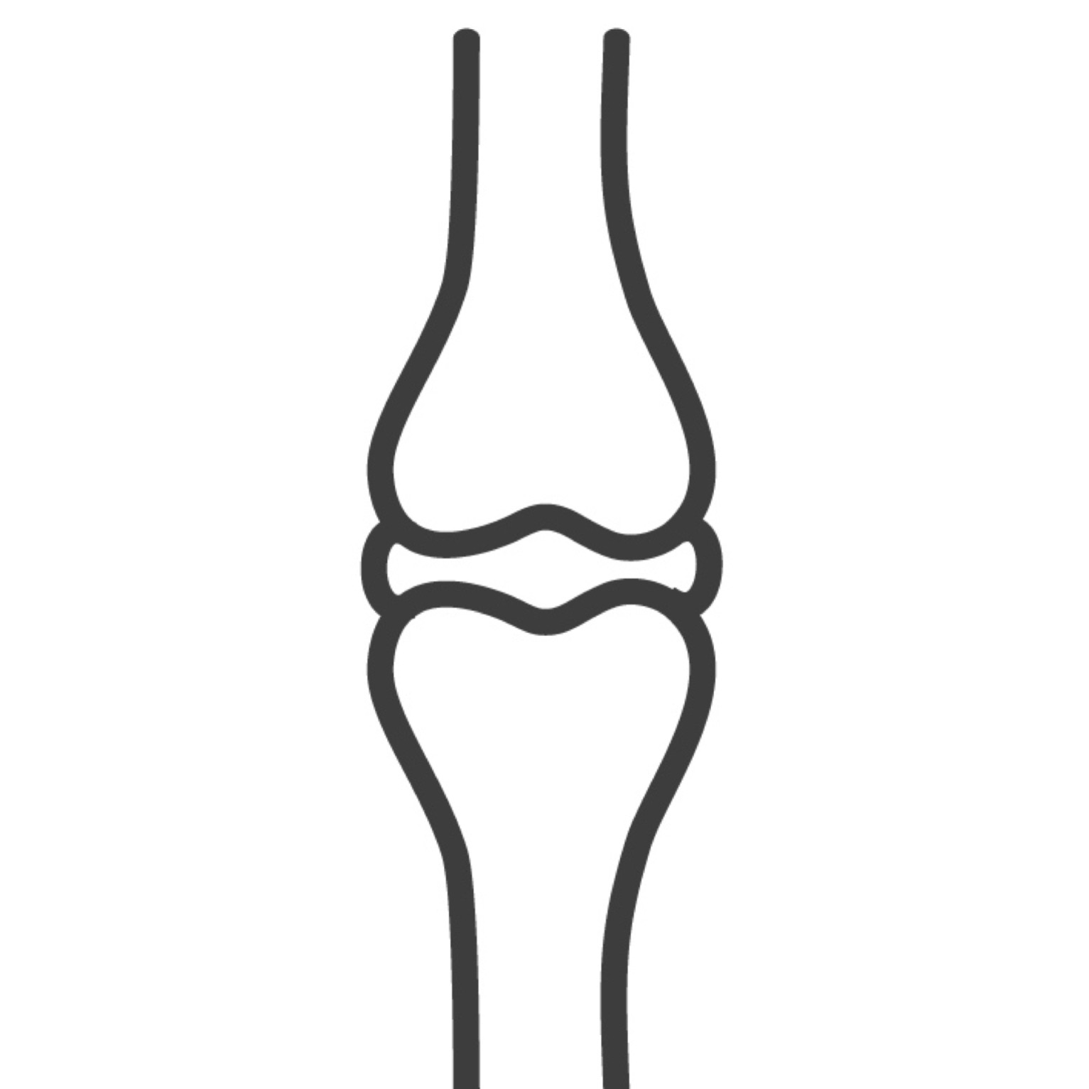
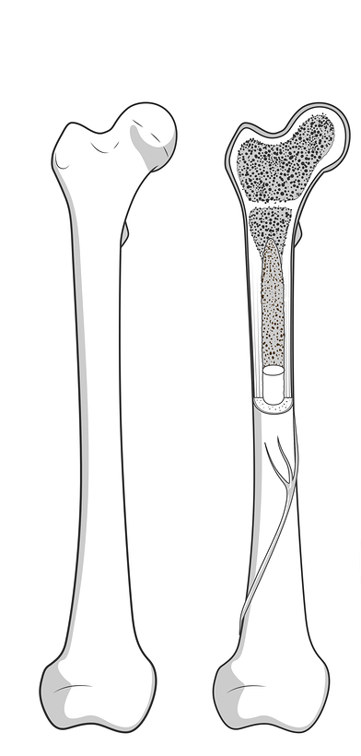
Anatomy of a Long Bone
Name _________________________
Date _________________Pd_______
Label the following structures:
articular cartilage
compact bone
diaphysis
distal epiphysis
epiphyseal line
medullary cavity
periosteum
proximal epiphysis
red marrow
spongy bone
yellow marrow
©Science Island

Slide 2
Anatomy of a Long Bone
ANSWER KEY
Label the following structures:
articular cartilage
compact bone
diaphysis
distal epiphysis
epiphyseal line
medullary cavity
periosteum
proximal epiphysis
red marrow
spongy bone
yellow marrow
articular cartilage
proximal epiphysis
spongy bone
red marrow
epiphyseal line
compact bone
medullary cavity
periosteum
diaphysis
yellow marrow
distal epiphysis
©Science Island

