Slide 1
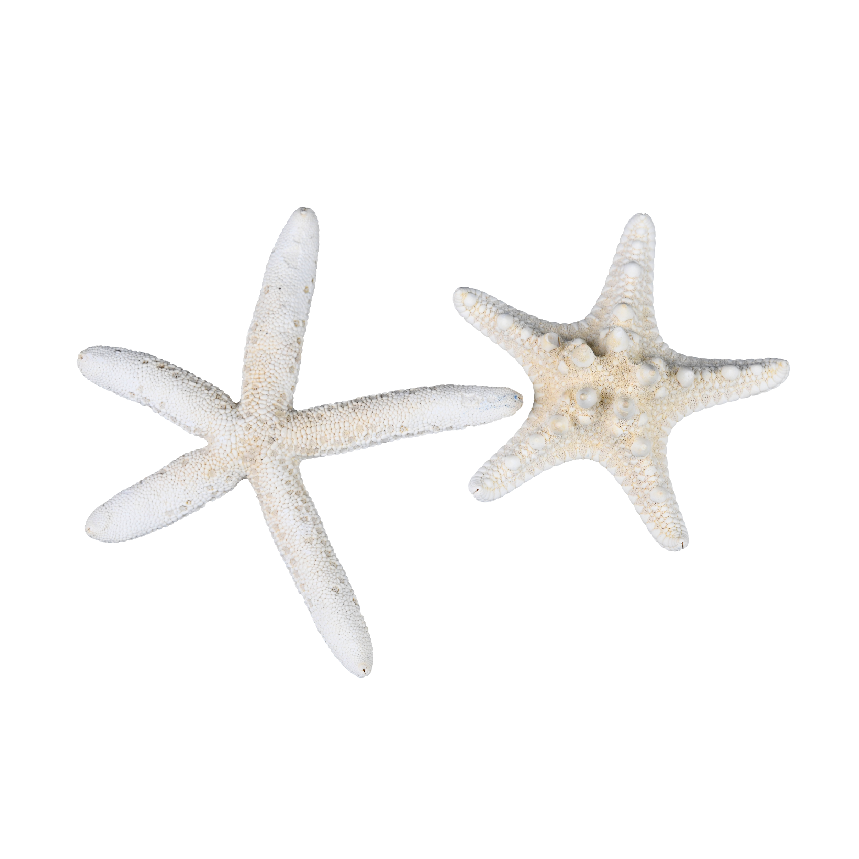
Starfish Anatomy Diagrams Teaching Tips
I like small groups for this activity. Students can take turns reading sections of the reading passage and discussing key sea star structures before labeling the diagrams.
Use this as a prelab activity if you are dissecting starfish.
I suggest copying the diagrams back-to-back. Two diagrams are included so students can easily see all key structures.
The reading passage can be laminated for repeated student use, or you can make a copy for each student if you prefer.
Instruct students to focus on the words in bold to help them decide which structures to label. Start with the most obvious ones first and then depend on your group members to determine the more difficult ones.
Project the color diagrams (Answer Key) for whole class review after the activity.
Optional: Students can add labels from diagram 1 onto diagram 2. This provides reinforcement and gives them a slightly different perspective. They can also add additional labels or notes as needed.
Please note: The reading passage is editable.
Differentiation: Give students the labeled diagram (Answer Key) and the reading passage to compare. They can add additional notes to the diagrams as needed.

Slide 2
Sea Star Anatomy Diagrams
Read the passage below and use the words in bold to identify the structures on the starfish diagrams.
Starfish or sea stars are members of Phylum Echinodermata along with sea urchins, sand dollars, and sea cucumbers. Echinoderm means “spiny skin” and this name comes from the calcium carbonate spines of the endoskeleton that often protrude through the skin. Although the larvae exhibit bilateral symmetry, adult sea stars show radial symmetry and most commonly have five arms.
The oral surface, where the mouth is located, is on the bottom or underside of the starfish. But, instead of taking food into the mouth, the starfish will often push out one of its two stomachs to engulf prey. This stomach, the cardiac stomach, secretes powerful digestive enzymes to break down the prey and then brings it into the body as the stomach comes back inside. The food is then transferred to the pyloric stomach which is located above the cardiac stomach and connected to the anus in the center of the top or aboral surface of the organism. Rectal glands near the anus function to store wastes before they are eliminated.
The pyloric stomach is also connected to pyloric ducts which extend down each arm and split into two ducts which lead to digestive glands. These glands, called pyloric caeca (singular, cecum), look like small pouches along the pyloric ducts and they produce enzymes and transport digested food throughout the body.
A pair of large gonads or sex organs can be found in each arm and, although sexes are separate, it is almost impossible to distinguish male gonads from female in preserved specimens.
A unique feature seen in sea stars and other echinoderms is a system of canals that carry water throughout the organism called the water vascular system. Water enters the system through the madreporite a reddish-orange structure located towards the center of the aboral surface. The stone canal is a tube that connects the madreporite to the circular ring canal. Radial canals extend from the ring canal and carry water down each arm to tiny bulbs called ampullae (singular, ampulla). Ampullae are attached at one end of the tube feet and surrounded by muscles; when muscles contract, the ampullae are squeezed and water moves into the tube foot to extend it, like the action of a medicine dropper. Tube feet are used for locomotion and capturing food and gas exchange.
On the oral side, an ambulacral groove extends from the mouth down each arm. Within each groove are four rows of hollow tube feet. This area is supported by an elongated area of endoskeleton called the ambulacral plate.

Slide 3
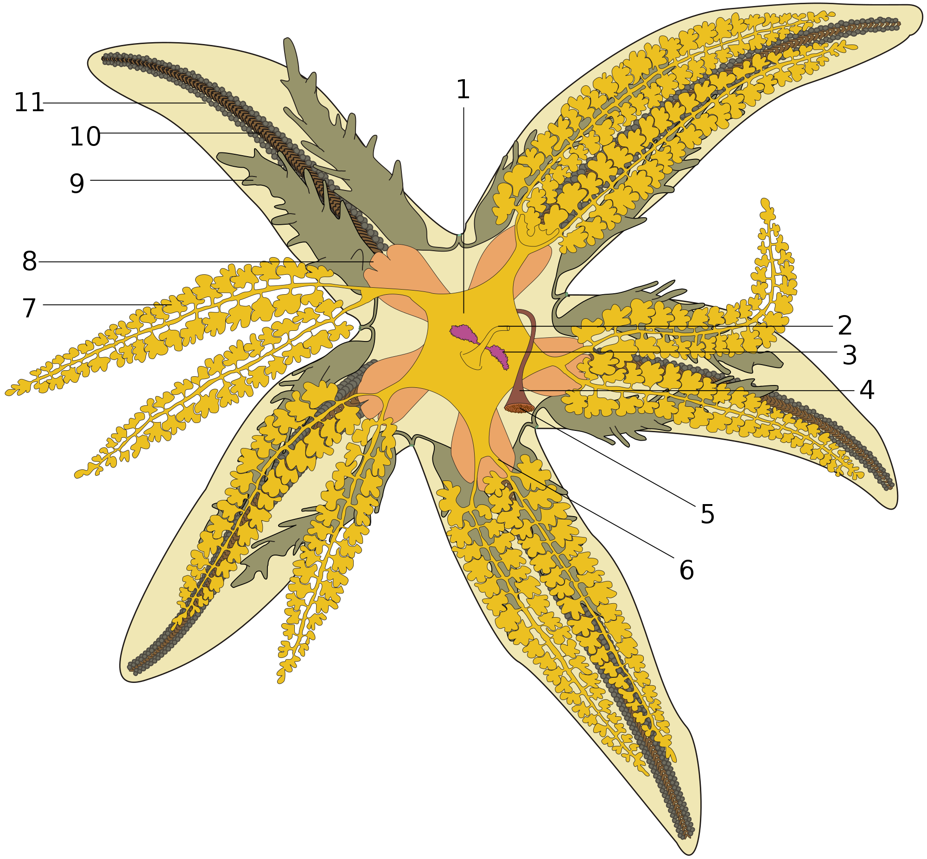
Sea Star Anatomy 1
_______________________
_______________________
_______________________
_______________________
_______________________
_______________________
_______________________
_______________________
_______________________
_______________________
_______________________
Notes:
Hans Hillewaert, License CC-BY-SA-3.0, https://commons.wikimedia.org/wiki/File:Asterias_rubens,_dissection.svg

Slide 4
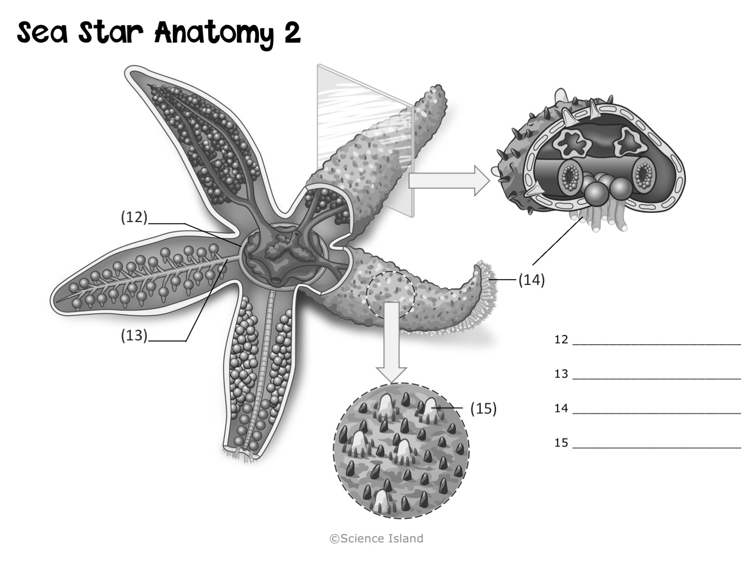
Notes:
Deposit Photos

Slide 5
Sea Star Anatomy 1
Answer Key
Pyloric stomach
Anus
Rectal glands
Stone canal
Madreporite
Pyloric ducts
Pyloric cecum
Cardiac stomach
Gonads (sex organs)
Ambulacral plate
Ampulla
Notes:
Hans Hillewaert, License CC-BY-SA-3.0, https://commons.wikimedia.org/wiki/File:Asterias_rubens,_dissection.svg

Slide 6
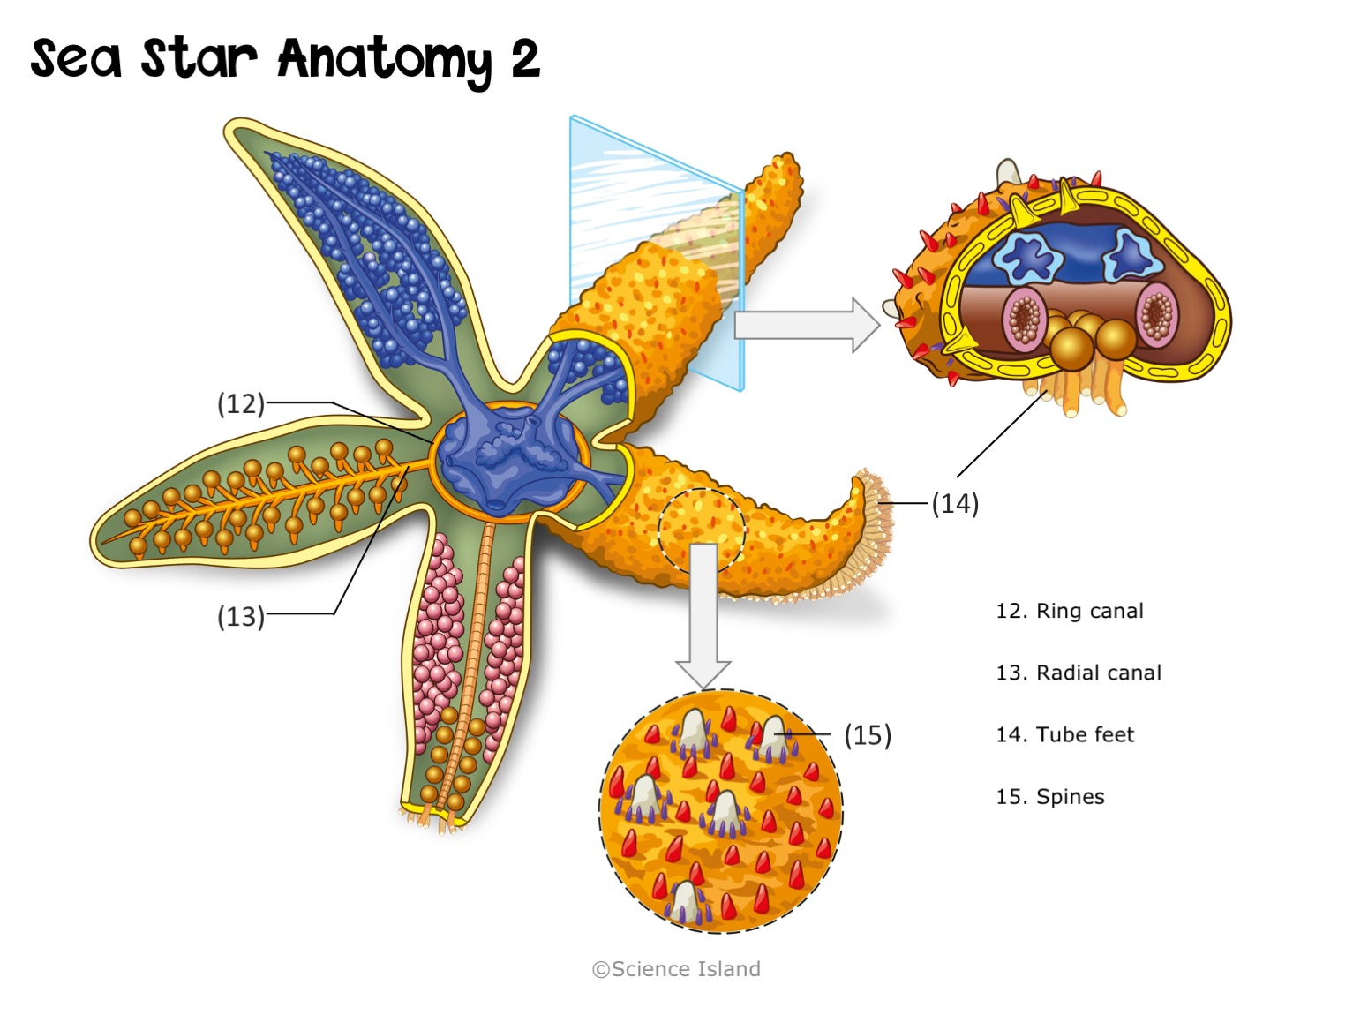
Answer Key
Notes:
Deposit Photos

